Slide 1


Binary
Search
B.Tech DAA Lab Presentation
Student Name : Devansh Rajpoot
Roll Number : 25070521031
:
Class : A1
Faculty Name : Dr. Parul Dubey

Slide 2











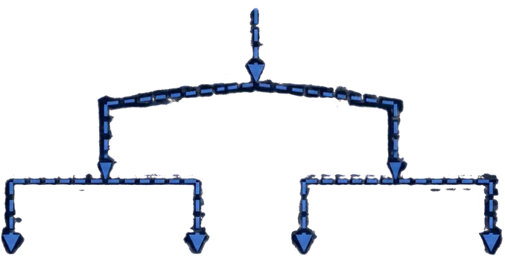

Introduction
Binary Search
2
5
8
12
16
23
38
50
61
An efficient searching algorithm designed for sorted arrays.
It quickly locates the position of a target value.
Widely used in computer science and software development.
Target Found

Slide 3


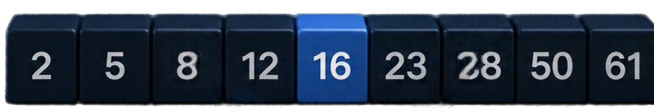
Problem Statement
Find a target value in a sorted array.
Linear search scans every element, taking O(n) time and becomes inefficient at scale.
Goal: return the index of the target if it exists, or report it as not found, using
fewer comparisons.

Slide 4
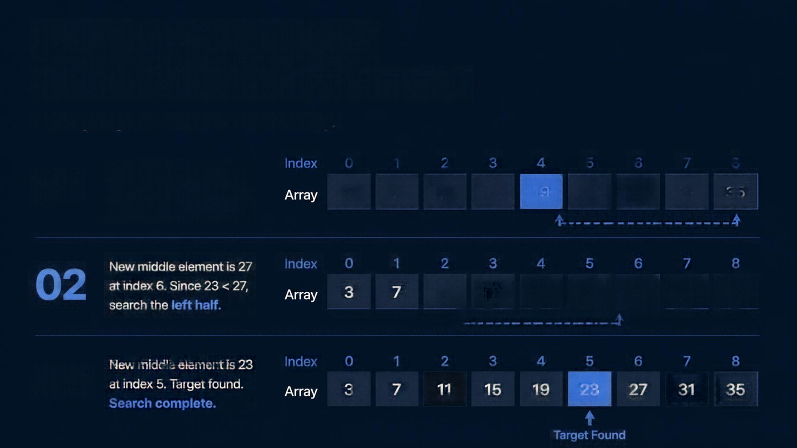






























Working Principle
with Sorted Array Example
Finding target value 23 in a sorted array.
Middle element is 19
at index 4. Since 23 > 19, search the right half.
Index
0
1
2
3
4
5
6
7
8
01
3
7
11
15
19
23
27
31
35
02
New middle element is 27 at index 6. Since 23 < 27, search the left half.
Index
0
1
2
3
4
5
6
7
8
3
7
11
15
19
23
27
31
35
03
New middle element is 23 at index 5. Target found.
Search complete.
Index
0
1
2
3
4
5
6
7
8
3
7
11
15
19
23
27
31
35
Target Found

Slide 5






01
Initialize the search range.
Set low = 0 and high = n - 1.
Step-by-Step Algorithm
02
Find the middle position.
Compute mid = (low + high) / 2.
A simple procedure to find a target in a sorted array.
Compare the middle element.
If equal, return mid.
03
Adjust the search range.
If the middle value is smaller, search right half. If it is larger, search left half.
04
05
Not found.
Return -1.

Slide 6



Pseudocode
Binary Search (Iterative)
procedure BINARY SEARCH(arr, target)
low < 0
// start at the first index
Find the position of
a target in a sorted array. Return its index if found, otherwise return -1.
high < length(arr) - 1
// start at the last index
while low < high
// repeat while range is valid
mid < (low + high) // 2
// find middle index
if arr[mid] = target
// target found
return mid
else if arr[mid] < target
// target is in right half
low < mid + 1
// discard left half
else
// target is in left half
high < mid - 1
// discard right half
return -1

Slide 7


Time and Space
Complexity
Best-case time complexity
O(1)
Average and worst-case time complexity
O(log n)
Space complexity (iterative)
O(1)

Slide 8







Advantages, Limitations, and Applications
01
Advantages
02
Limitations
03
Applications
Fast search on sorted data
Requires sorted array
Searching in databases
Simple to implement
Not suitable for linked lists without indexing
Libraries
Low memory usage
Coding competitions
System utilities

Slide 9

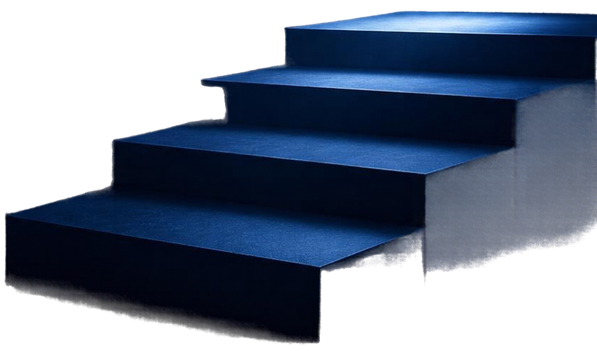
Conclusion and References
Binary Search is an efficient searching algorithm with logarithmetic time complexity.
It requires sorted data to work correctly.
It is widely used in computer science and
software development.
References
Introduction to Algorithms by Cormen, Leiserson,
Rivest, and Stein
Thank you!
Online tutorials and documentation
Questions are welcome.

